Slide 1
Mocking

Slide 2
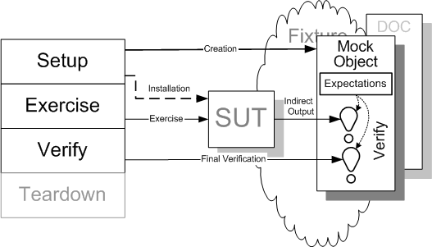
Mocking and Stubbing

Slide 3
When do you use it?
Code you are testing depends on remote services
Database
Web services
Behavior you don’t have control on.
E.g. Time and Date.

Slide 4
How do you use it (Moq)?
Object interactions
Method called correctly.
Correct parameters are passed.
var mock = new Mock<IPrice>();
mock.Setup(foo => foo.CalculateRental(It.IsAny<string>()))
.returns(10);

Slide 5
What do you test?
Object interactions
Method called correctly.
Correct parameters are passed.
mock.Verify(foo => foo.CalculateRental("ping"));

Slide 6
What do you test?
How your objects work for various responses from other objects

Slide 7
Suggestions
Mock instead of creating ‘new’ objects
Don’t mock any methods of SUT
Only mock those methods that SUT calls

Slide 8
Mocking Demo

Slide 9
Mocking Exercise
Statement Controller Mocking Exercise

